Slide 1
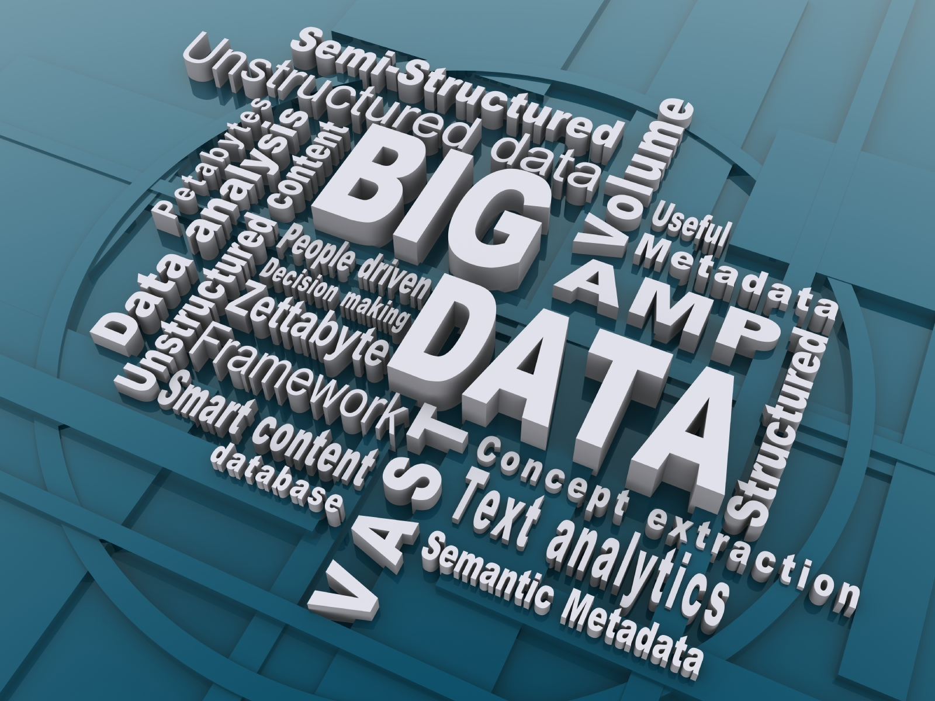
BIG DATA
Prepared By
Nasrin Irshad Hussain And Pranjal Saikia
M.Sc(IT) 2nd Sem
Kaziranga University Assam

Slide 2
Content
Introduction
What is Big Data
Characteristic of Big Data
Storing,selecting and processing of Big Data
Why Big Data
How it is Different
Big Data sources
Tools used in Big Data
Application of Big Data
Risks of Big Data
Benefits of Big Data
How Big Data Impact on IT
Future of Big Data

Slide 3
Introduction
Big Data may well be the Next Big Thing in the IT world.
Big data burst upon the scene in the first decade of the 21st century.
The first organizations to embrace it were online and startup firms. Firms like Google, eBay, LinkedIn, and Facebook were built around big data from the beginning.
Like many new information technologies, big data can bring about dramatic cost reductions, substantial improvements in the time required to perform a computing task, or new product and service offerings.

Slide 4
What is BIG DATA?
‘Big Data’ is similar to ‘small data’, but bigger in size
but having data bigger it requires different approaches:
Techniques, tools and architecture
an aim to solve new problems or old problems in a better way
Big Data generates value from the storage and processing of very large quantities of digital information that cannot be analyzed with traditional computing techniques.

Slide 5
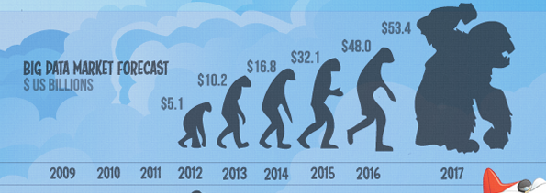
What is BIG DATA
Walmart handles more than 1 million customer transactions every hour.
• Facebook handles 40 billion photos from its user base.
• Decoding the human genome originally took 10years to process; now it can be achieved in one week.

Slide 6
Three Characteristics of Big Data V3s
Volume
Velocity
Data Speed
Variety
Data Types
Data quantity
Notes:
Acco.to IBM
6

Slide 7
1st Character of Big Data Volume
A typical PC might have had 10 gigabytes of storage in 2000.
Today, Facebook ingests 500 terabytes of new data every day.
Boeing 737 will generate 240 terabytes of flight data during a single flight across the US.
The smart phones, the data they create and consume; sensors embedded into everyday objects will soon result in billions of new, constantly-updated data feeds containing environmental, location, and other information, including video.

Slide 8
2nd Character of Big Data Velocity
Clickstreams and ad impressions capture user behavior at millions of events per second
high-frequency stock trading algorithms reflect market changes within microseconds
machine to machine processes exchange data between billions of devices
infrastructure and sensors generate massive log data in real-time
on-line gaming systems support millions of concurrent users, each producing multiple inputs per second.

Slide 9
3rd Character of Big Data Variety
Big Data isn't just numbers, dates, and strings. Big Data is also geospatial data, 3D data, audio and video, and unstructured text, including log files and social media.
Traditional database systems were designed to address smaller volumes of structured data, fewer updates or a predictable, consistent data structure.
Big Data analysis includes different types of data

Slide 10
Storing Big Data
Analyzing your data characteristics
Selecting data sources for analysis
Eliminating redundant data
Establishing the role of NoSQL
Overview of Big Data stores
Data models: key value, graph, document, column-family
Hadoop Distributed File System
HBase
Hive

Slide 11
Selecting Big Data stores
Choosing the correct data stores based on your data characteristics
Moving code to data
Implementing polyglot data store solutions
Aligning business goals to the appropriate data store

Slide 12
Processing Big Data
Integrating disparate data stores
Mapping data to the programming framework
Connecting and extracting data from storage
Transforming data for processing
Subdividing data in preparation for Hadoop MapReduce
Employing Hadoop MapReduce
Creating the components of Hadoop MapReduce jobs
Distributing data processing across server farms
Executing Hadoop MapReduce jobs
Monitoring the progress of job flows

Slide 13
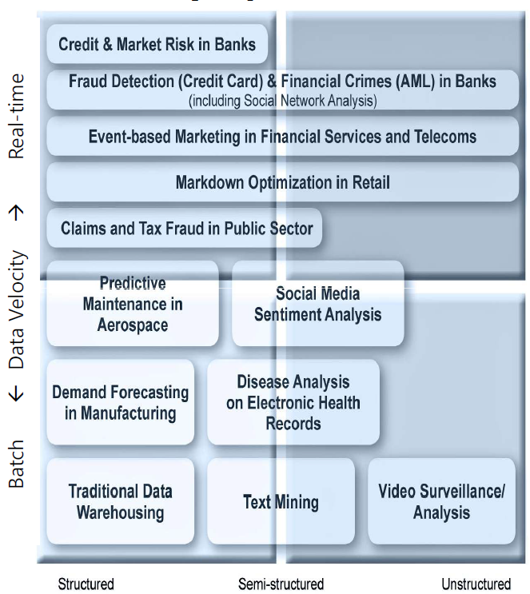
The Structure of Big Data
Structured
Most traditional data sources
Semi-structured
Many sources of big data
Unstructured
Video data, audio data

Slide 14
Why Big Data
Growth of Big Data is needed
Increase of storage capacities
Increase of processing power
Availability of data(different data types)
Every day we create 2.5 quintillion bytes of data; 90% of the data in the world today has been created in the last two years alone

Slide 15
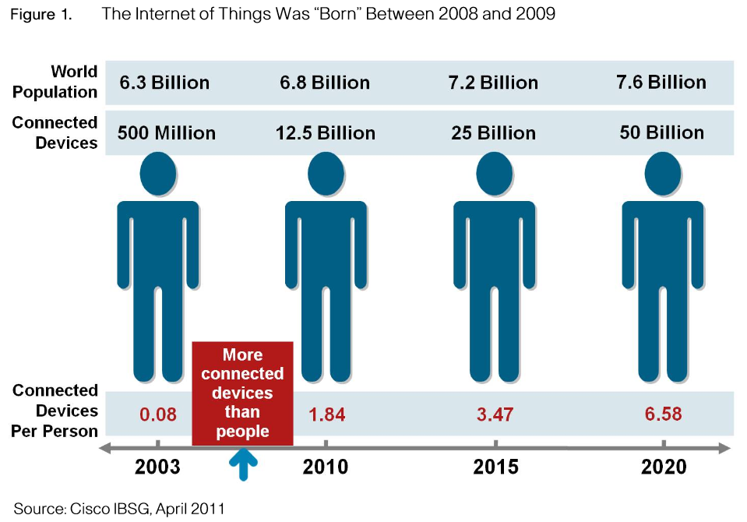
Why Big Data
FB generates 10TB daily
Twitter generates 7TB of data
Daily
IBM claims 90% of today’s
stored data was generated
in just the last two years.

Slide 16

How Is Big Data Different?
1) Automatically generated by a machine
(e.g. Sensor embedded in an engine)
2) Typically an entirely new source of data
(e.g. Use of the internet)
3) Not designed to be friendly
(e.g. Text streams)
4) May not have much values
Need to focus on the important part

Slide 17
Big Data sources
Users
Application
Large and growing files
(Big data files)
Systems
Sensors

Slide 18
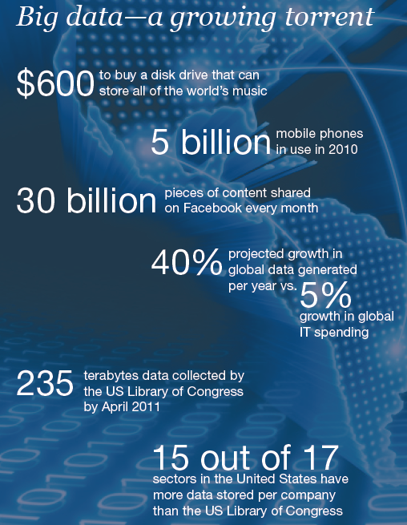
Data generation points Examples
Mobile Devices
Microphones
Readers/Scanners
Science facilities
Programs/ Software
Social Media
Cameras

Slide 19
Big Data Analytics
Examining large amount of data
Appropriate information
Identification of hidden patterns, unknown correlations
Competitive advantage
Better business decisions: strategic and operational
Effective marketing, customer satisfaction, increased revenue

Slide 20
Types of tools used in Big-Data
Where processing is hosted?
Distributed Servers / Cloud (e.g. Amazon EC2)
Where data is stored?
Distributed Storage (e.g. Amazon S3)
What is the programming model?
Distributed Processing (e.g. MapReduce)
How data is stored & indexed?
High-performance schema-free databases (e.g. MongoDB)
What operations are performed on data?
Analytic / Semantic Processing

Slide 21
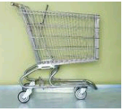

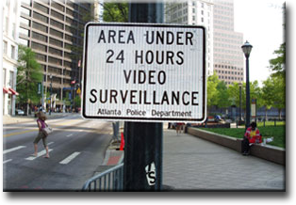


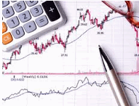
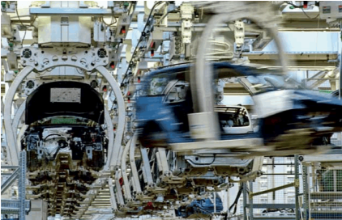

A Application Of Big Data analytics
Smarter Healthcare
Multi-channel sales
Homeland
Security
Telecom
Traffic Control
Trading
Analytics
Search
Quality
Manufacturing
Notes:
Quote practical examples

Slide 22

Risks of Big Data
Will be so overwhelmed
Need the right people and solve the right problems
Costs escalate too fast
Isn’t necessary to capture 100%
Many sources of big data
is privacy
self-regulation
Legal regulation

Slide 23
Leading Technology Vendors
Example Vendors
IBM – Netezza
EMC – Greenplum
Oracle – Exadata
Commonality
MPP architectures
Commodity Hardware
RDBMS based
Full SQL compliance

Slide 24
How Big data impacts on IT
Big data is a troublesome force presenting opportunities with challenges to IT organizations.
By 2015 4.4 million IT jobs in Big Data ; 1.9 million is in US itself
India will require a minimum of 1 lakh data scientists in the next couple of years in addition to data analysts and data managers to support the Big Data space.

Slide 25
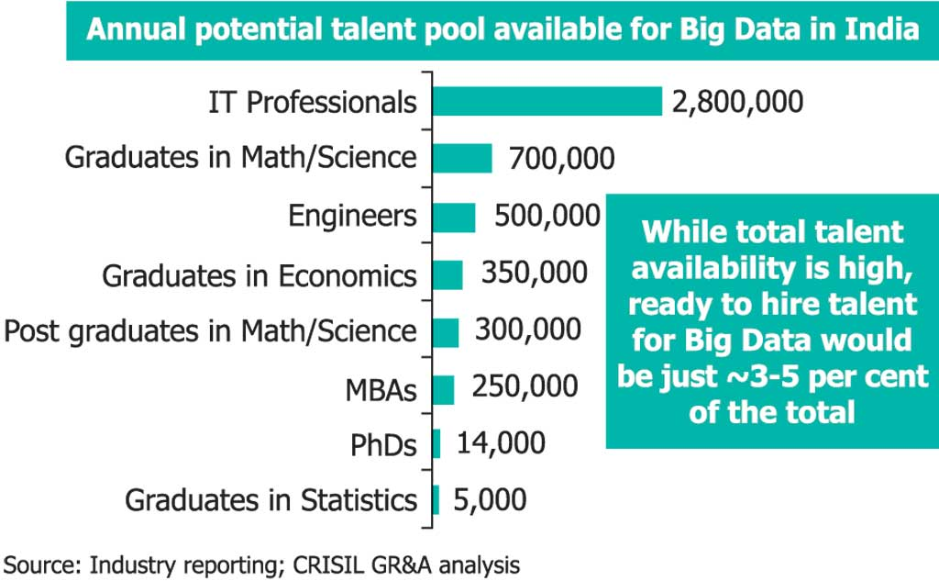
Potential Value of Big Data
$300 billion potential annual value to US health care.
$600 billion potential annual consumer surplus from using personal location data.
60% potential in retailers’ operating margins.

Slide 26
India – Big Data
Gaining attraction
Huge market opportunities for IT services
(82.9% of revenues) and analytics firms
(17.1 % )
Current market size is $200 million. By 2015 $1
billion
The opportunity for Indian service providers lies
in offering services around Big Data
implementation and analytics for global
multinationals

Slide 27
Benefits of Big Data
Real-time big data isn’t just a process for storing petabytes or exabytes of data in a data warehouse, It’s about the ability to make better decisions and take meaningful actions at the right time.
Fast forward to the present and technologies like Hadoop give you the scale and flexibility to store data before you know how you are going to process it.
Technologies such as MapReduce,Hive and Impala enable you to run queries without changing the data structures underneath.

Slide 28
Benefits of Big Data
Our newest research finds that organizations are using big data to target customer-centric outcomes, tap into internal data and build a better information ecosystem.
Big Data is already an important part of the $64 billion database and data analytics market
It offers commercial opportunities of a comparable
scale to enterprise software in the late 1980s
And the Internet boom of the 1990s, and the social media explosion of today.

Slide 29
Future of Big Data
$15 billion on software firms only specializing in data management and analytics.
This industry on its own is worth more than $100 billion and growing at almost 10% a year which is roughly twice as fast as the software business as a whole.
In February 2012, the open source analyst firm Wikibon released the first market forecast for Big Data , listing $5.1B revenue in 2012 with growth to $53.4B in 2017
The McKinsey Global Institute estimates that data volume is growing 40% per year, and will grow 44x between 2009 and 2020.

Slide 30
References
www.Slideshare.com
www.wikipedia.com
www.computereducation.org
Books-
Big Data by Viktor Mayer-Schonberger

Slide 31
Thank You.

